Slide 1




SPACE INVADERS
K. J. Somaiya College of Engineering, Mumbai – 400 077
(A Constituent College of Somaiya Vidyavihar University) Dept. of Science and Humanities, F.Y. B. Tech. Semester –II (2020-22)
Group Members:
Python mini project C2 Group.no-17
Names | Roll.no
Anirudh Ta | 16010121199
Chirag Sharma | 16010121186
Kedar Shidhaye | 16010121187

Slide 2


The Purpose of choosing Space invaders as a project
To venture into Game development as beginners.
To make use of Python skills to develop a game.
To understand and implement multiple functionalities.
To develop a basic understanding of pygame.aries and modules.

Slide 3

Libraries / modules Used
Sr.no | Library/Module | Important Functions
1 | Pygame | pygame.image.load()
 |  | pygame.transform.scale()
 |  | pygame.font.SysFont()
 |  | win.blit()
 |  | pygame.event.get()
2 | Sys Module | sys.exit()
3 | Time Module | time.sleep()
 |  | pygame.time.Clock()
4 | Random Module | random.randrange()
 |  | random.choice()
5 | MySQL connector | cursor.execute()
 |  | cursor.fetchall()

Slide 4
Major Functions
Functions | Use/Purpose
terminate() | Exits from the game when called.
button() | Defines position and size of button along with the message. Then tracks mouse movements and clicks then accordingly makes the button glow and when clicked calls the required function.
text_objects() | Builds the surface on which text is written and determines its font.
message_display() | Displays text in desired location.
button_text() | Determines position and text to be displayed inside the button.
game_intro() | Runs the GUI of the game.
collide() | Detects collision between various objects.

Slide 5
Login/Sign up with MySQL
Functions | Purpose
Login() | Takes user name and password of registered players as input
Login_2() | Checks if the username exists in the database. Also checks for incorrect password
Sign_up() | Takes user name and password of new players as input
Sign_up2() | Checks if username already exist. If not then registers the new player in table
Crash() | Checks if the current player score is more than their previous high score and update the player’s personal high score. Display the global high score and if the player has beaten the global high score

Slide 6
Classes
ship
Here Class ‘ship’ stores various attributes of all the ships irrespective of their type.
Then classes ‘player’ and ‘enemy’ inherit some of their attributes from the parent class ‘ship’.
Along with that they also have some of their own attributes.
player(ship)
Enemy(ship)

Slide 7
Class ship: Parent class
Sr.no | Methods of class ship | Use/Purpose
1 | def__init__() | It defines various fundamental properties like health, load images of ships and their lasers, velocity, a list to store these lasers & co-ordinates of the ships.
2 | draw() | It displays the images of ship and its laser on the screen.
3 | move_laser() | It moves various lasers and detect collisions.
4 | cooldown() | It ensures that there is a small time interval between 2 consecutive lasers fired.
5 | shoot() | It shoots laser on command or randomly depending on type of ship.

Slide 8
Class Enemy(ship):
Sr.no | Methods of class ship | Use/Purpose
1 | def__init__() | It defines various fundamental properties like health, load images of ships and their lasers, a list to store these lasers, score of player and kill count by shots hit & co-ordinates of the ships
2 | move() | It moves all the enemy ships in the downward directions at a specific velocity.
3 | shoot() | Shoots laser at random time intervals using random module.

Slide 9
Class Player(ship):
Sr.no | Methods of class ship | Use/Purpose
1 | def__init__() | It defines various fundamental properties like health, load images of ships and their lasers, a list to store these lasers, score of player and kill count by shots hit & co-ordinates of the ships.
2 | move_laser() | It moves all the lasers which belongs to the player ship, then detects their collision with enemy ship and the deletes them while incrementing the score and kill count.
3 | health_bar() | It displays a health bar to provide visual indicator of ship’s health under the player ship which updates whenever the ship is hit.

Slide 10
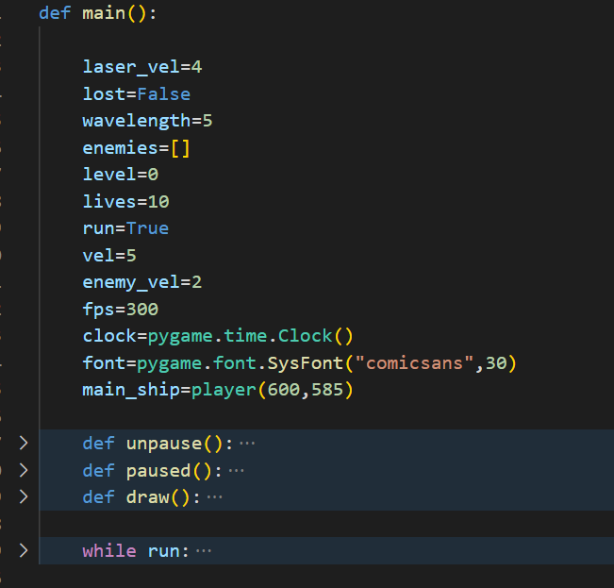
Main():
Functions | Use/Purpose | Images
Pause() & unpause() | These are used to pause and unpause the game by displaying the pause screen with a resume and a quit button.
draw() | Here we draw all the ships, laser, labels like scores, kill count, lives, levels. While updating the screen at the set fps using time module.
Game loop | Here we take input from the keyboard for movement of the ship and shooting lasers. It also calls all the functions and methods above.

Slide 11
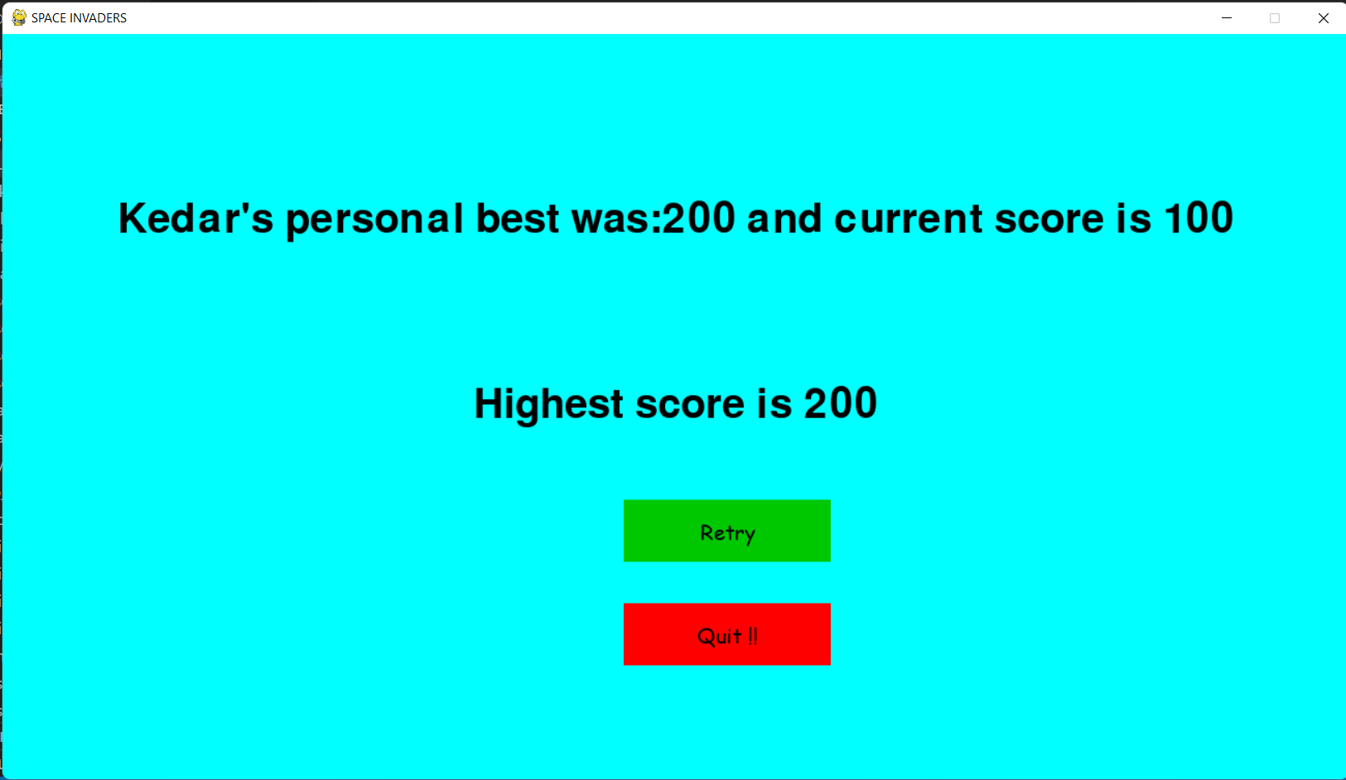
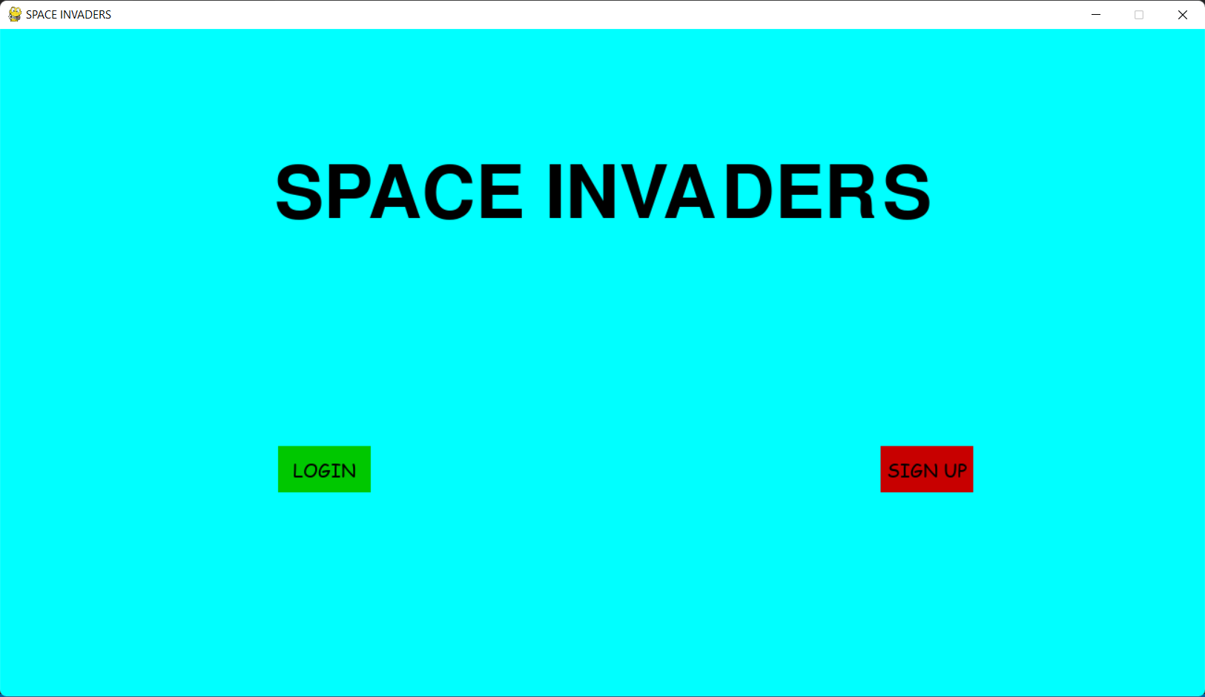
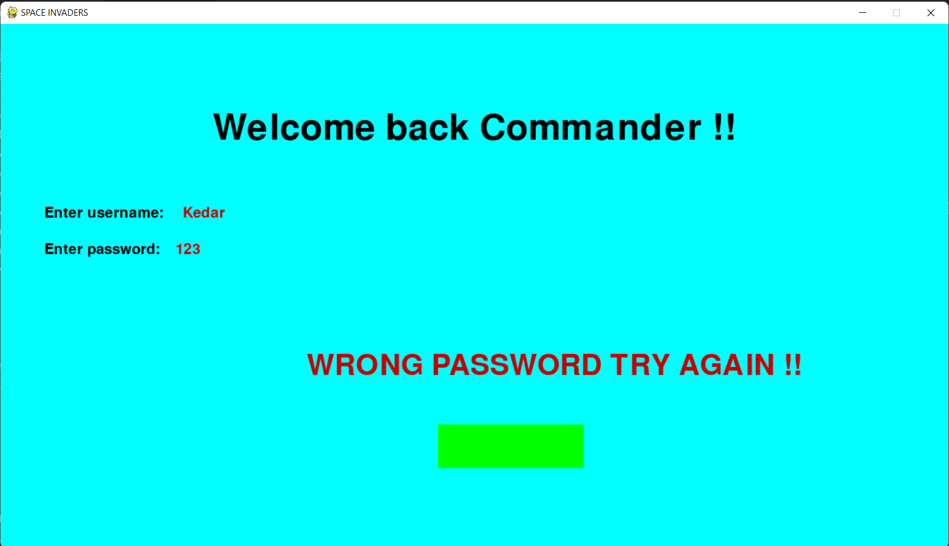
TEST RUN

Slide 12
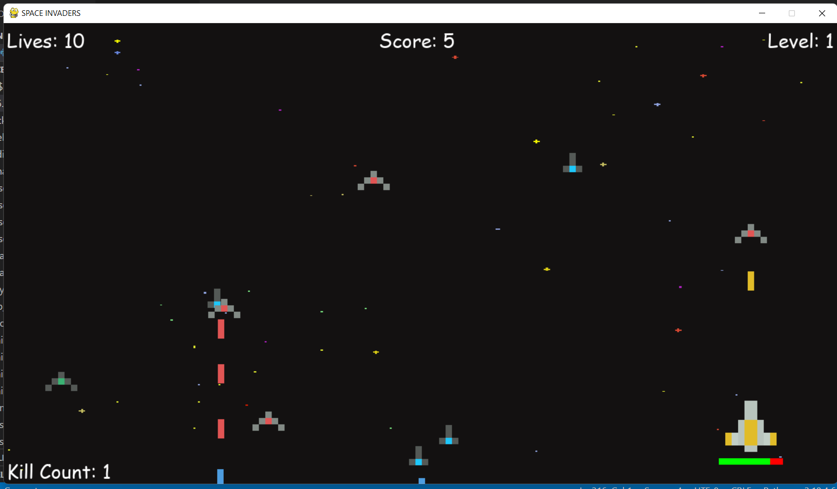
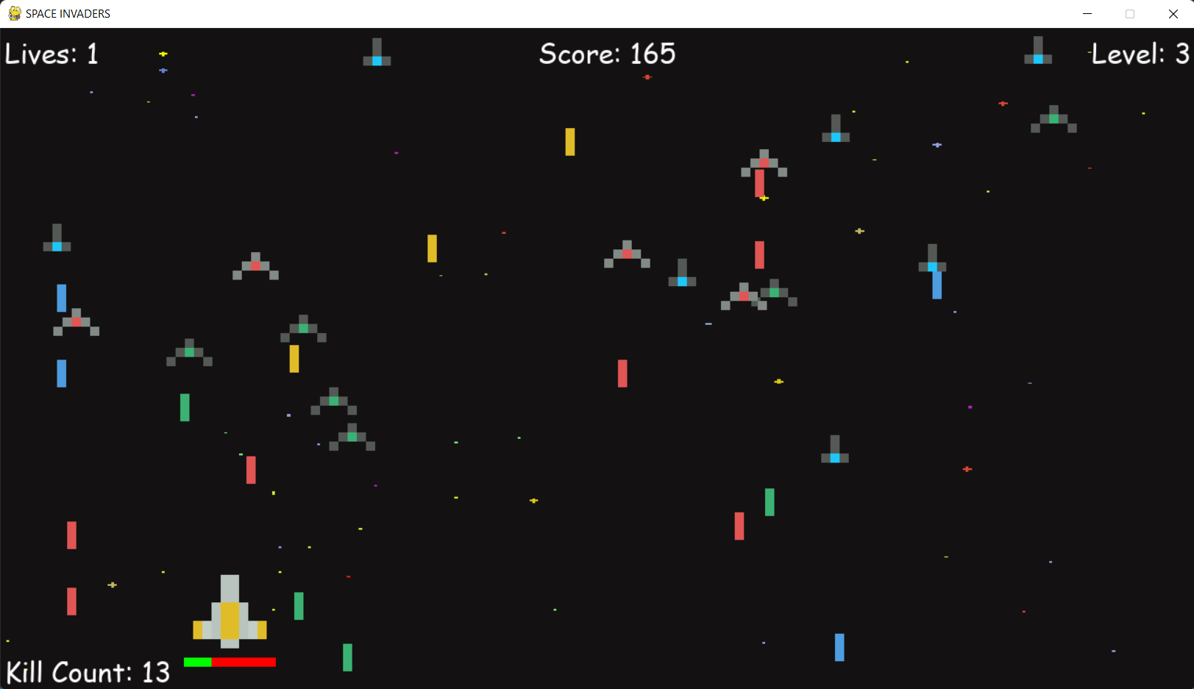
TEST RUN

Slide 13
References:
https://www.youtube.com/watch?v=jh_m-Eytq0Q
https://www.youtube.com/watch?v=Q-__8Xw9KTM

Slide 14
THANK YOU!

